Slide 1
VHDL Taster Project
Philip Abbey

Slide 2
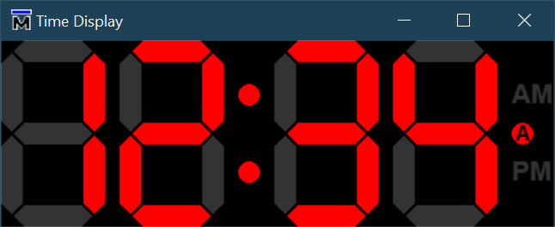
Simple Project – Retro Alarm Clock
Basics
Given
Clock
Pulse Per Second (PPS)
Limited number of panel buttons
Tell 24 hour time
Extensions
Tell 12/24 hour time
One or more alarms
Stop watch mode (with lap)
Count down timer
Insights into synthesis results
28
PPS
FPGA
100 MHz Clock
n
Bell
Panel Buttons
Notes:
7 segment display has no visual representation. It is possible to write a Wish/TCL GUI but is a deviation from the main aims.

Slide 3
Minimum Target
Drive 4 digits of a clock display
These can simply be VHDL outputs driving four seven segment displays
Use a design with a single clock for all synchronous logic
Provide a means of setting the time via a small number of “buttons” (design inputs)
Set / Up / Down (as required)
Using a finite state machine or otherwise…
A test bench to demonstrate the design
Submit your design via Git for review
Keep a list of the topics you discover you don’t know for discussion

Slide 4
Tools
As a minimum you will need a Xilinx Vivado Webpack installation
Provides both simulation and synthesis
No licence required
\\lead\Xilinx\Vivado 2020.1\Xilinx_Unified_2020.1_0602_1208.tar.gz
An alternative is to install Quartus Prime Lite
Provides synthesis and
A free but limited version of ModelSim
You might like to create a compilation script (batch file) using vlib, vmap, vcom (and vsim) to avoid repetitive point & click
\\lead\IT Software Library\General Q-T\QuartusPrime\QuartusLiteSetup-20.1.1.720-windows.exe
Notes:
Xilinx's Vivado (I think this is 'Webpack' too when no license is used)
\\lead\Xilinx\Vivado 2020.1\Xilinx_Unified_2020.1_0602_1208.tar.gz
Intel's Quartus Prime
\\lead\IT Software Library\General Q-T\QuartusPrime\QuartusLiteSetup-16.1.0.196-windows.exe
\\lead\IT Software Library\General Q-T\QuartusPrime\QuartusLiteSetup-20.1.1.720-windows.exe

Slide 5
Stretch Opportunities
Functional
Swap the clock’s settings between 12h and 24h display
Set one or more alarms to be optionally triggered by an “alarm on” setting
Stop watch mode (with lap)
Count down timer
Synthesis
Choose any device you fancy, it matters little here
“Elaborate” your design to generic gates and understand the logic inferred by your code
Inspect the log file to identify things that look ominous
Search the Internet to find out what they mean (we’ve all made those mistakes)
Be ready to talk through the key features of your code and how it is realised in logic gates
“Synthesis” (mapping to a particular technology) and explain how generic gates are mapped to a real device
You will get all sorts of warnings, lack of constraints, pin allocations etc. Ignore them.

Slide 6
Stretch Opportunities
Swap Vivado’s simulator for ModelSim
You are offered a rudimentary “display” to drive
Your VHDL outputs can be hooked up to the display using TCL
Instructions are provided at the end
We appreciate this tool may not be available for your use
You can get a free version of ModelSim by installing the Quartus Prime Webpack synthesis tool which includes a limited edition of ModelSim and is sufficient for this task. You are not obliged to do this.

Slide 7
Not Expected
Writing constraints for synthesis
Understanding timing reports
Re-working your code to resolve timing issues from synthesis
Clock domain crossings
Use a single clock for all synchronous logic

Slide 8
Hints
VHDL is a hardware description language
Think of the logic first then write the code to describe it
If you’re not enjoying this job as much as I do each day, you’re doing it wrong.
Have some fun
VHDL Tutorials
VHDL Whiz
Nandland
TutorialsPoint
FPGA Tutorial
FPGA4student
NB. Nandland have a known errata
They are slightly confused about some details of finite state machines
Look else where for that!

Slide 9
Vivado Installation
This will occupy 780 MB on completion

Slide 10
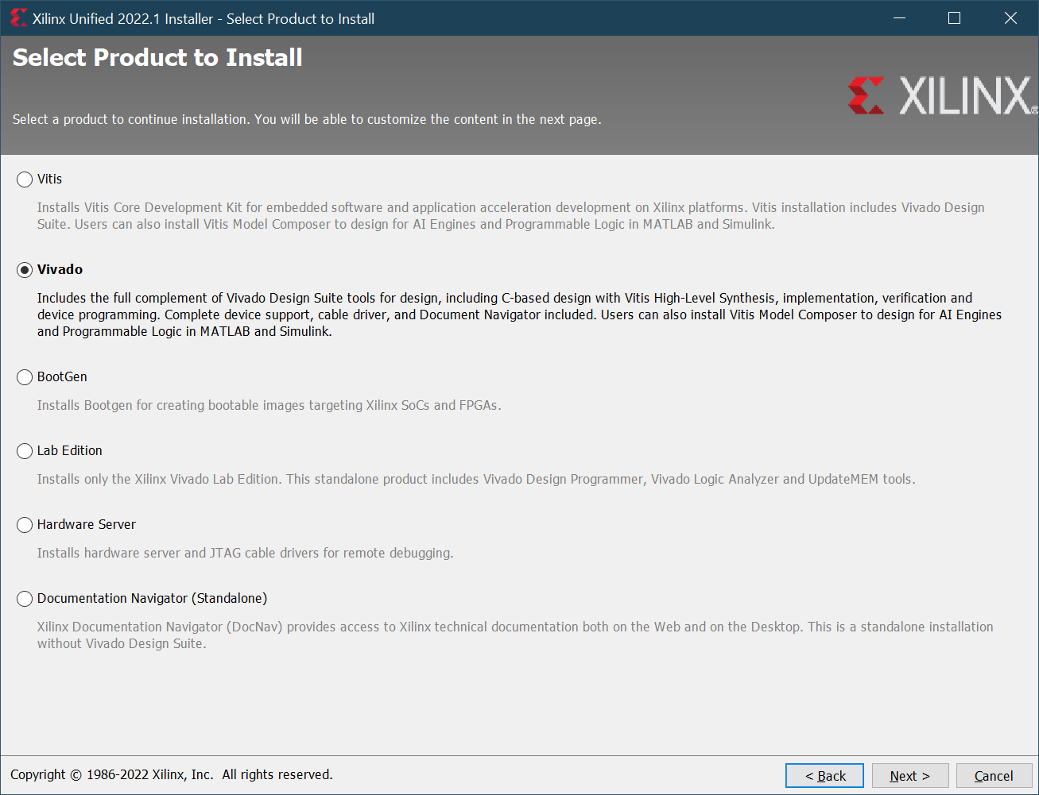
Vivado Installation 1
Check you PC’s disk space
Ensure you have ~55GB spare for Vivado ver 2019
~110GB for ver 2022!
Actually, a Webpack installation can be nearer to a mere 22GB or 85GB respectively.
Using the following options we can trim the installation down
Vivado (not Vitis)

Slide 11
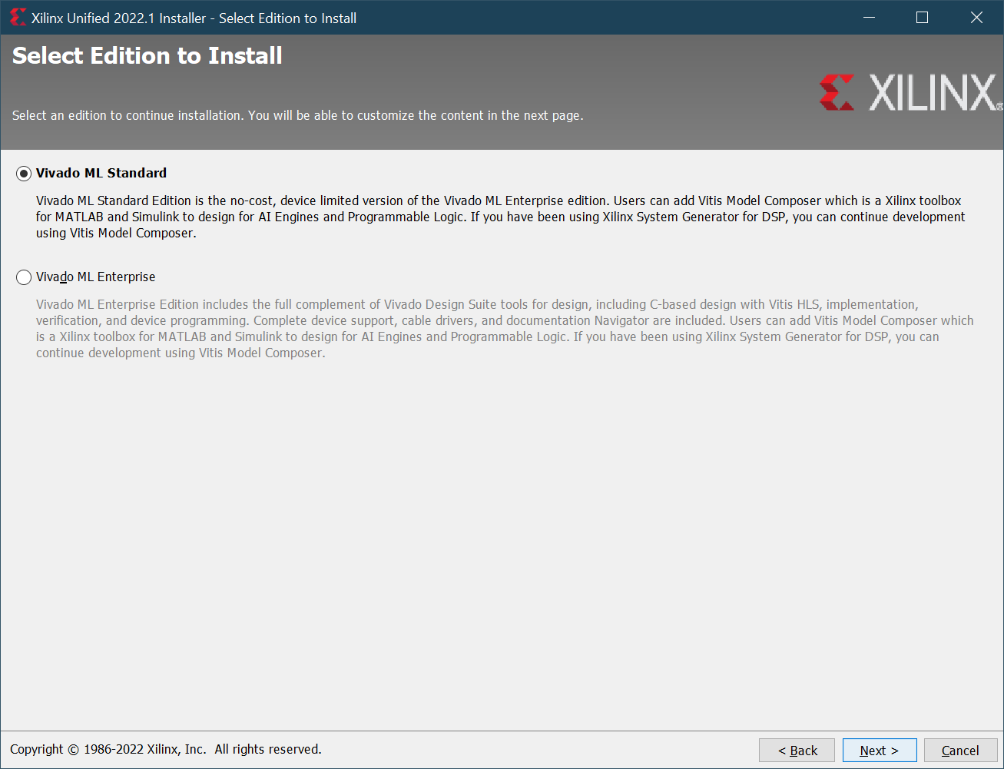
Vivado Installation 2
Vivado ML Standard

Slide 12
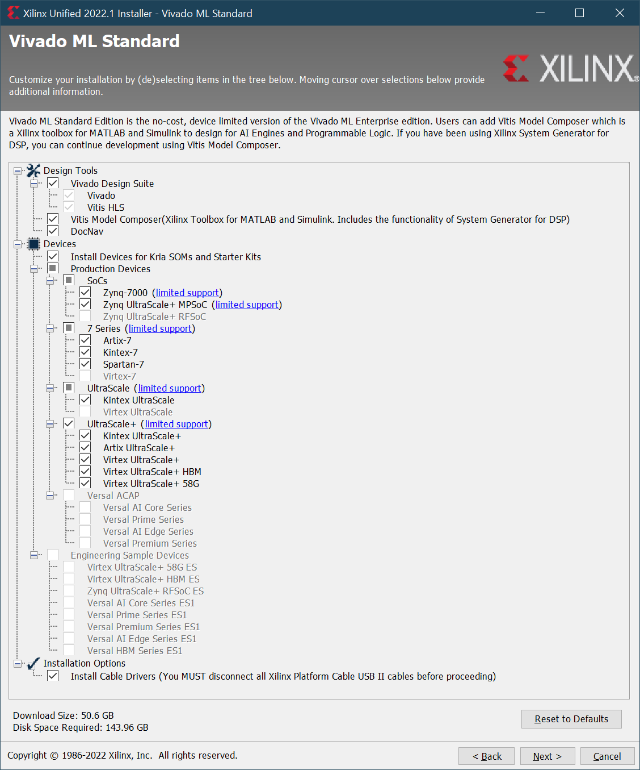
Vivado Installation 3
Trim the devices down if you are short on disk space
E.g. just Kintex UltraScale
Keep DocNav
In case Vivado offers you a help link
No need for Matlab Simulink
No need for cable drivers
You can return to the installer for anything you missed

Slide 13
Simulated Display - Optional
ModelSim only (sorry)

Slide 14
VHDL Assumptions or Pre-requisites
sevseg_pkg.vhd
library ieee;
use ieee.std_logic_1164.all;
package sevseg_pkg is
<snip>
type time_disp_t is array (0 to 3) of std_logic_vector(6 downto 0);
<snip>
end package;
time_display.vhd
entity time_display is
port(
<snip>
disp : out work.sevseg_pkg.time_disp_t;
<snip>
);
end entity;
A 4 element array of 7 bits each to drive the graphical display

Slide 15
Driving the display from TCL
Save this TCL file locally
Amend your VHDL test bench simulation signal names to match:
Delete any you do not plan on using and amend “proc display_cursor” to suit.
Open your simulation in ModelSim
Source the sevseg_display.tcl TCL script in the ModelSim TCL shell
This should open up the graphical display in a separate window and set up the update trigger
source {path\to\sevseg_display.tcl}
run -all multiple times until completion
As provided, the update event calls a function which includes a “stop” call to pause the simulation so you can see the change to the display before it runs to the next value too quickly.
set disp {/test_time_display/disp}
set alarm {/test_time_display/alarm}
set am {/test_time_display/am}
set pm {/test_time_display/pm}

Slide 16
Good Luck!

